Slide 1
Standard User – Approve:
Initiate an Approval, Present Contract
August, 2013

Slide 2

Learning Objectives
Upon completion of this course you will be able to:
Understand the Review process in ECM
Initiate a Contract Approval using the ‘Present’ option

Slide 3
Approval Process Overview
All negotiations with external parties should be conducted through the 'check in/check out' functionality. A negotiation begins with Presentation, which usually requires approvals to occur before the presentation can take place.
If a clause-level approvals list applies to a clause, clause approval is required if its language changes, it is replaced by an alternate, it is deleted, or another reason applies (see User Guide).
    To initiate approvals for a clause, either (a) on the Contract Editor Language tab, go to Clause Approvals and click Initiate Clause Approval (new in V10); or (b) in the Word Editor, click Approve on the clause toolbar. Initiation and execution of Clause approvals must be one clause at a time.
    If a clause requires approval but no approvals lists apply, acceptance of changes by the other party is still required. If the changes are rejected, the changed item reverts to its previous state.

Slide 4
Approval Process Overview, cont.
Once clause-level approvals are complete, contract-level approval is required. To initiate approvals for a contract, the user with the Draft Contract or Negotiate Contract task selects the Present (or Execute) option. ECM will determine if approval is required, based on the existence of an approvals list.
Approvals can be configured differently per the client's needs. Examples are: Template-based (pre-defined Approvals List) vs. Value-based (Rule Set applied to Term values) approvals.
In new implementations it is recommended to keep approval requirements simple, until more user experience is gained and the need for more complexity is determined.

Slide 5
Approval Chain
When a Clause Template or Contract Template is developed, the approval “chain” is determined. Approval chains can also be affected by Term values and other contract properties, but this is only via Rule Sets, as discussed in the Administration topics.
Approvers are individuals (single or multiple) or user groups, organized in levels.
When a contract is sent out for approval, each named individual at a given approval level, and any member of each group at that approval level, must approve the contract before it moves to the next level of approvers. If anyone rejects the approval request, the approval request is stopped and must be restarted. (Organizations can also play a role: next slide.)
All members of an Approval level receive an email notification and a Task simultaneously, and they can approve simultaneously. However, if contract editing is allowed during approval (this is not recommended), only a single Approver at a time can open the Word Editor for the Approval Clause/Contract.
Each Approval level must be cleared, i.e., all Approvals completed affirmatively, before email notifications and Tasks are passed on to members of the next Approval level
If the contract author is uncertain where the contract is in the approval process, click the Pending Tasks icon to determine the outstanding tasks, if any.

Slide 6
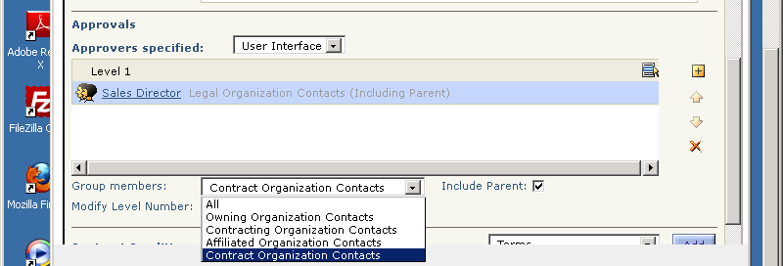
Approval Groups & Organizations
When a user group is named as an approval group, the default is for all members of that group to receive an approval notification and task.
It is possible to override the above default so that only group members who are contacts of certain organizations related to the contract are asked to approve. As shown below, the choices are Owning, Contracting, or Affiliated organizations, plus “Contract Organization”, which includes all of the other three.
(The previous bullet implies that it is important to specify the appropriate organizations by their roles, when creating or editing a contract.)

Slide 7
Approval Levels - Example
Below is an example of how Approval Levels work.
Level 1
Level 2
Level 3
Level 4
B1
C1
A
C2
D
B2
C3
In this example:
If A represents an individual: when A approves, Level 2 approval is initiated, and everyone at that level receives a notification task simultaneously.
If B1 is a group and B2 is a list of five individuals: anyone in B1 plus everyone in B2 must approve before Level 3 approval is initiated.

Slide 8
Approval Process Overview, cont.
Unlike the contract Review process, the Approval process is mandatory, once configured.
  The contract lifecycle process is suspended until the approval process is complete.
  A contract cannot proceed to the next phase of the contract lifecycle until all approvals are returned.
Also, when a contract is sent for approval, the contract language is locked and cannot be changed during the approval process. (It is possible to override this and allow edits during approval, but this is not recommended, so we assume no edits will occur.)
The response to an approval task is Accept or Reject.
  The approver can respond with “accept” or “reject” but cannot make changes to the contract as part of the approval task (by default; see above).
  And, the author cannot make changes if the contract is out for approval.
Note: If the contract is changed after approvals are complete, it will need to go through the approval process again (except in certain unusual and not recommended configurations).
Note when testing approvals: If you put the contract owner as approver, approval may take place automatically, instead of a task being created for the user. Also, if the same user would be asked to approve twice, the second task might not be issued.

Slide 9
Reviews vs. Approvals
Reviews:
  are for initiating feedback on and updates to a draft contract
  do not have a built-in workflow defined for them
  are ad hoc requests, not predefined processes
  do not require a reply, although one is normally expected
  have tracking of changes and responses
Approvals:
  once configured, are mandatory for presentation and/or execution to complete
  have a pre-built workflow with approvers defined during configuration
  generally occur when the contract language is “final”; it is strongly recommended not to allow editing during the approval process
  are triggered by one or more elements in a Boolean way, with possible variation based on metadata values; e.g., discount > 10%, or terms > 30 days
  have tracking of responses

Slide 10

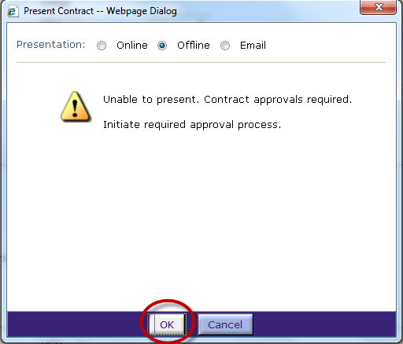
Initiate Approvals
Click the Present icon from any tab on the main, blue toolbar.
The Present Contract dialog box is displayed.
Notice the message that you are unable
to present the contract (immediately)
and that contract approvals are required.
This may seem like an error, but it's normal.
You must initiate approvals for this contract.
Click OK.

Slide 11
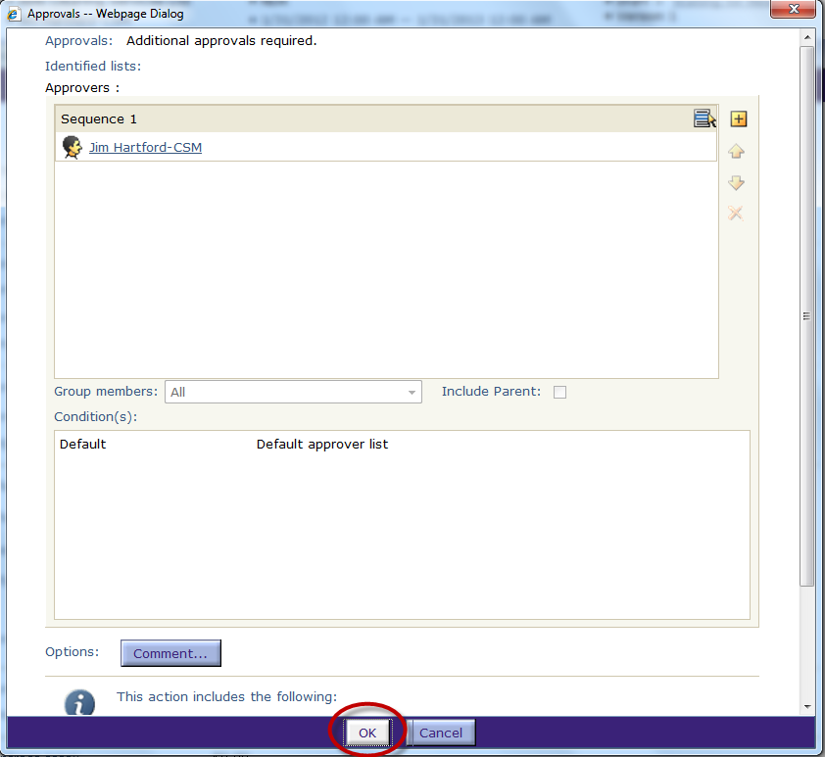
Approvals Dialog Box
The Approvals dialog box lists the approval levels and members.
The approvers may be individuals or groups.
If there is a group, you can list the
members of the group by clicking
on the group name hyperlink.

Slide 12
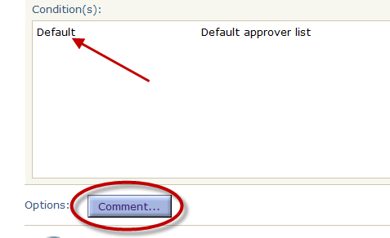
Approval Trigger Conditions
You can view the conditions that triggered the approval process.
The Condition(s) box describes the condition or rule for the approval. For this example, you see that this is a Default Approval.
Enter a comment about the Approval task.
  Click the Comment… button.
The Comment dialog box is displayed.

Slide 13
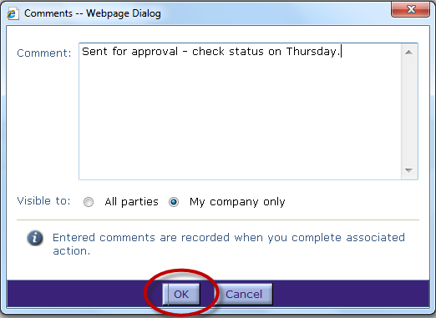

Enter a Comment
Enter comments to indicate what action is needed, when it is needed, etc.
Select whether the comments are Visible to:
  All Parties (internal and external parties)
Note that many of the dialog
boxes include information
about the action that will be
taken.
Click OK when done.
The Approvals dialog box
is re-displayed.

Slide 14
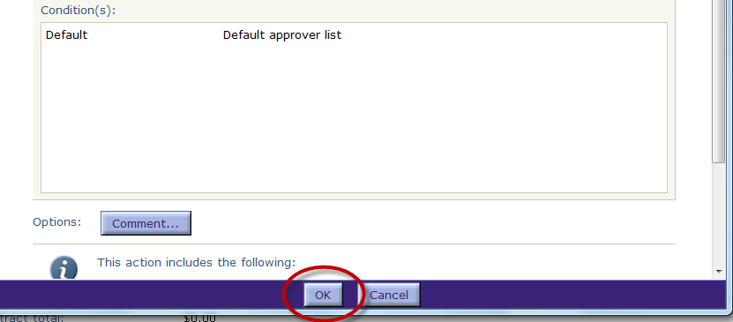

Send for Approval
Click OK to initiate the approval process.
Notice the actions described in the Information section of the Approvals dialog box; these will occur when approvals are initiated.
The document is closed and an approval notification email is sent to the first name(s) on the list. They will also receive an Approval task in their My Tasks section.
Be sure to Close the contract on the Contract Editor bar so that Approvers can open it.
Note: The default is for the contract to be ‘locked’, precluding any editing activities until all approvals are received.

Slide 15
Contract Presentation
Presentation only applies to Authored and Received contracts and amendments (not Filed ones)
Previously we talked about how Presentation initiates the approval process. After all of the required clause-level and contract-level approvals have been obtained, the next time you Present, the actual presentation will occur, assuming the other requirements are met, such as values for all mandatory Terms.
During Presentation time, the presentation method is chosen from among the allowed options for the Organization, as set in the System Settings. The possible methods are:
    Online: The external party receives email notification from Emptoris. He/she logs in to Emptoris and edits the contract as required. Since this requires external parties to both have Emptoris user accounts and knowledge of how to use ECM, this option is seldom used.
    Offline: The person presenting the contract manually emails the checked out version to the external party, who edits it and sends it back for check in . This is the most common approach.
    Email: Like Offline, but Emptoris email notification with attached contract takes place. This requires the external party to be defined (correctly) as an External Contact (or User) in VSM, which implies ongoing administration effort.
If the presentation method is Online or Email, another choice to be made at Presentation is Negotiability. This can be Accept/Decline (“take it or leave it”) or Negotiable, or the default from the contract template can be used.

Slide 16

Questions?

